Slide 1

Question Answering
On CJRC Dataset
(Chinese judicial Reading Comprehension)
Liancheng Gong
Xinyao Han
Qiaowei Li
Notes:
Due date is May 13 7am Shanghai time.
Each presentation is 9mins (Content) + 2 mins (QA) = 11 mins.
https://drive.google.com/file/d/1cENEb5FgVNPUYtY6Lppw_FZfpeZJ6Hnt/view

Slide 2
Contents
01
Problem Situation
02
Descriptive Analytics
03
Problem Solving
04
Error Analysis
05
Future Work
🠺
🠺
· significance · problem description · expected difficulties
· dataset description · data cleaning · visualization
· Pre-trained model · Classification model · QA model
· Classification attempts · Out of memory · Tokenizer
· Slide window · Multi-task model · Tokenizer · Answer YES/NO

Slide 3
Contents
🠺
🠺
Final presentation The final presentation is an opportunity for you to showcase your work. You will probably want to follow a structure similar to:
1. Problem situation: what is the problem? Reflect on why it's important. What are the difficulties?
2. Descriptive analytics: Which data did you get? Any interesting insights/visualizations?
3. Machine Learning: How did you tackle the problem?
4. Future work: If you had infinite time, what would you envision the next steps to take are? How will you improve the results?

Slide 4
1
Problem Situation
T
1
🠺
🠺
Significance
Problem Description
Expected Difficulties

Slide 5
Significance
T
1
🠺
🠺
Tons of cases form legal judgements (composed of summary of cases, descriptions of events, count opinions, judgement results).
Different judgement results on same case.
A time consuming process to extract relative information.s
Notes:
There are thousands of cases happening on a daily basis, which form loads of legal judgments.
Compared to the number of judgments, the number of judges are relatively small; and though in similar cases, the judgment results can sometimes be very different. These difficulties make it challenging for judges to extract information from legal documents.
Therefore, the introduction of NLP into the legal field can assist judges and lawyers in obtaining required information in a more efficient and convenient way.

Slide 6
MRC Solution
T
1
🠺
🠺
Span-Extraction MRC on Chinese legal judgment documents.
Notes:
Our project hopes to study machine reading comprehension, especially answer extractions in the field of legal judgment documents.

Slide 7
Expected Difficulties
T
1
🠺
🠺
Chinese corpus datasets
Added ‘YES/NO’ answer to the SQuAD dataset
Notes:
Compared with well studied English characters dataset as SQuAD, this project will focus on Chinese corpus datasets, which needs special tokenization. Moreover, yes and no answer should be added to the

Slide 8
2
Descriptive Analytics
T
2
🠺
🠺
dataset description
data cleaning
visualization

Slide 9
CJRC Dataset
(Chinese Judgement Reading Comprehension)
T
2
🠺
🠺
Public legal judgment documents from the “China Judgment Documents Network”
Civil and criminal judgments
Descriptions of 10,000 judgments issued by the Supreme People's Court of China
Legal experts marked 4 to 5 Question Answer pairs
Big_train_data.json, Dev_ground_truth.json, test_ground_truth.json
The datasets imitate format with SQuAD 2.0.
Notes:
Our main dataset is a public legal judgment documents from the “China Judgment Documents Network” including civil and criminal judgments. The training set contains about 40,000 questions, the development set and the test set each contains about 5,000 questions. For the training set, each question contains only one standard answer. For the development and test sets, each question contains 3 human-labeled inference answers. The answer content can be a fragment of the case, YES or NO, or empty if the answer is rejected. This dataset is in JSON format. Here is an example for dev and test set:
Tokenization is needed for data preprocessing.

Slide 10
Case of Auction | e139eef6-fc0c-4953-acec-a83a0095ce4e.txt
Case Name | 保险人代位求偿权纠纷
Case Description | 经审查,原告提供的证据1-3、被告中华联合广东分公司提供的证据4-5、被告万友公司提供的证据6,各方对其真实性均没有异议,本院对其真实性予以确认综合本院采信的证据及当事人的陈述,本院认定以下事实:2015年6月1日,田x17驾驶粤A×××××号车辆与严x3驾驶的赣C×××××号重型仓栅式货车发生碰撞,造成两车不同程度损坏的交通事故交警部门作出事故认定书,认定严x3承担事故的全部责任,田x17不负事故责任粤A×××××号车辆在原告处投保了保险金额为908000元的机动车损失保险,事故发生在保险期间内事故发生后,粤A×××××号车辆的被保险人陈x18就该车辆的损失以财产保险合同纠纷起诉至佛山市禅城区人民法院案经审理,佛山市禅城区人民法院于2015年8月18日作出(2015)佛城法民二初字第1006号民事判决,查明粤A×××××号车辆经广州市华盟价格事务所有限公司评估,损失价格为241541元,陈x18支付了粤A×××××号车辆的维修费241541元、评估费9050元;本案原告在庭审中明确表示不申请重新对车辆损失进行评估鉴定并判决原告向陈x18支付粤A×××××号车辆损失保险理赔款250591元2015年10月11日,原告向陈x18赔付了250591元及诉讼费用2529元后原告提起本案之诉并查明,赣C×××××号车辆的所有人为被告万友公司,该车辆在被告中华联合广东分公司处投保了交强险,事故发生在保险期内事故发生后,被告中华联合广东分公司向该车辆的被保险人许x19赔付了2000元诉讼中,被告徐11确认其为该车辆的实际支配人,严x3是被告徐11雇请,是从事派遣工作过程中发生案涉交通事故被告徐11与被告万友公司签订《车辆挂靠合同书》,被告万友公司同意被告徐11就赣C×××××号车辆挂靠被告万友公司名下

Slide 11
Q&A Pairs | {'answer_start': 153, 'text': '两车不同程度损坏'}], 'id': 'e139eef6-fc0c-4953-acec-a83a0095ce4e.txt_001', 'is_impossible': 'false', 'question': '事故结果如何？'} {'answer_start': 180, 'text': '严x3承担事故的全部责任,田x17不负事故责任'}], 'id': 'e139eef6-fc0c-4953-acec-a83a0095ce4e.txt_002', 'is_impossible': 'false', 'question': '事故由谁承担什么责任？'} {'answer_start': 233, 'text': '机动车损失保险'}], 'id': 'e139eef6-fc0c-4953-acec-a83a0095ce4e.txt_003', 'is_impossible': 'false', 'question': '投保人所投保险险种？'} {'answer_start': 225, 'text': '908000元'}], 'id': 'e139eef6-fc0c-4953-acec-a83a0095ce4e.txt_004', 'is_impossible': 'false', 'question': '向原告投保的人所投保险的保险金额是多少？'} {'answers': [], 'id': 'e139eef6-fc0c-4953-acec-a83a0095ce4e.txt_005', 'is_impossible': 'true', 'question': '牌号为粤A×××××号的车辆是何种类型？'}

Slide 12
Extract answer directly from the legal judgment documents
E.g. Q: 事故结果如何？ A: 两车不同程度损坏
Yes/No answer
E.g. Q:双方协议原告需要承担费用吗？ A: NO
Question unable to answer
E.g. Q: 牌号为粤A×××××号的车辆是何种类型？A: /
Q&A types in our dataset
T
2
🠺
🠺
Notes:
Our main dataset is a public legal judgment documents from the “China Judgment Documents Network” including civil and criminal judgments. The training set contains about 40,000 questions, the development set and the test set each contains about 5,000 questions. For the training set, each question contains only one standard answer. For the development and test sets, each question contains 3 human-labeled inference answers. The answer content can be a fragment of the case, YES or NO, or empty if the answer is rejected. This dataset is in JSON format. Here is an example for dev and test set:
Tokenization is needed for data preprocessing.

Slide 13
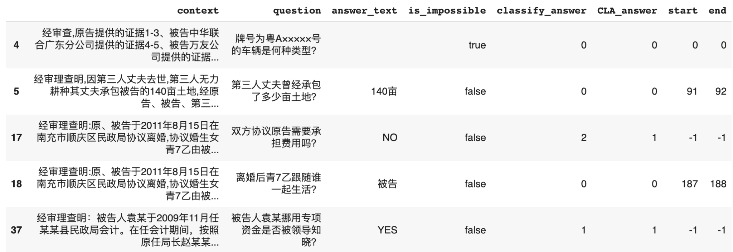
Dataset Description
T
2
🠺
🠺

Slide 14
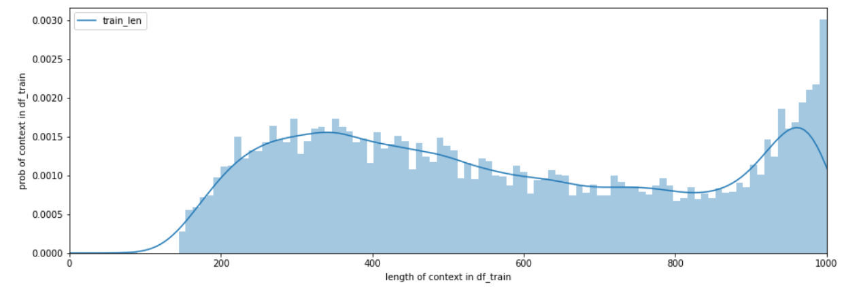
Visualization of context length
On average, context contains 572 word length, with minimum word length of 80, maximum word length of 1000. 75% of the data contains a context word length of 806.

Slide 15
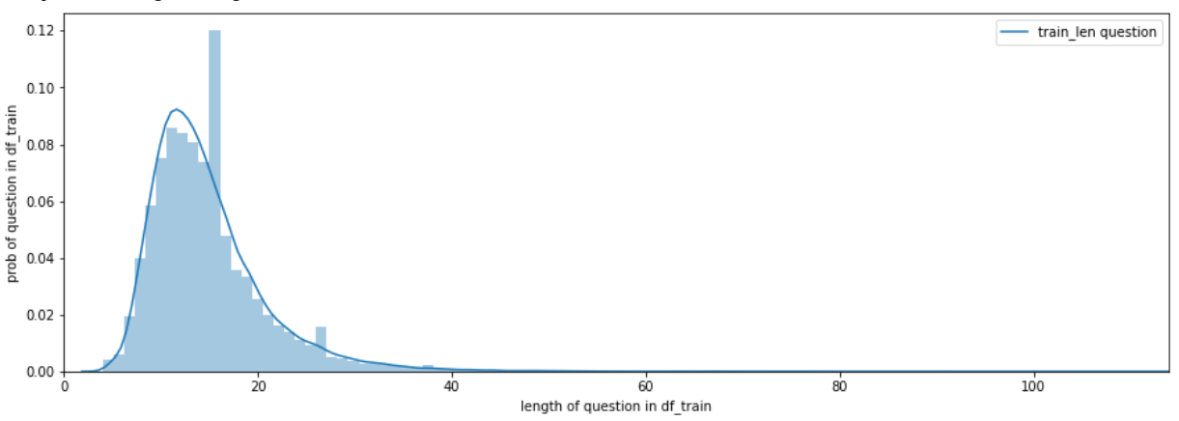
Visualization of question length
On average, question contains 14 word length, with minimum word length of 4, maximum word length of 114. 75% of the data contains a context word length of 17.

Slide 16
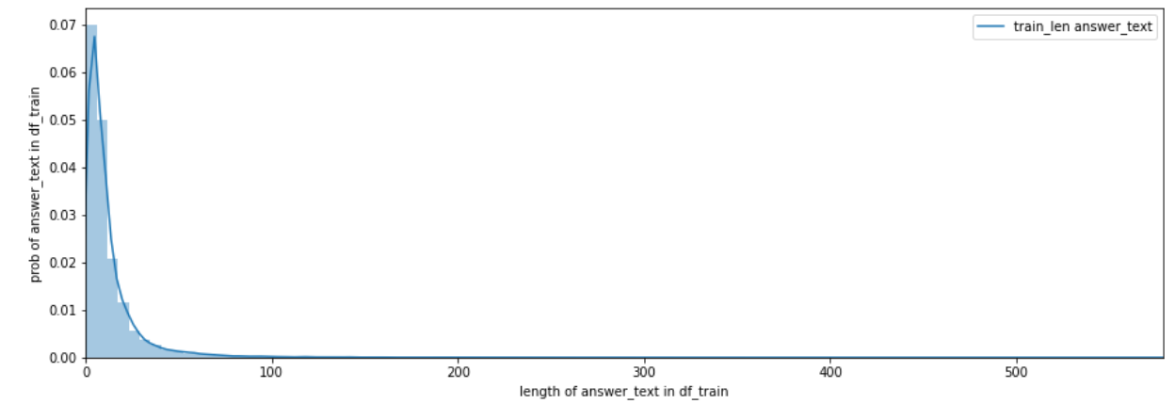
Visualization of answer length
On average, answer_text contains 12 word length, with minimum word length of 0 (impossible to answer given context), maximum word length of 579. 75% of the data contains a context word length of 12.

Slide 17
Text truncation
Bert only takes 512 tokens…
We hope to have input tokens as
[CLS] Question [SEP] Context [SEP]
Context: …...C×××××号重型仓栅式货车发生碰撞, 造成两车不同程度损坏的交通事故交警部门作出事故认证........
Question: 事故结果如何？
Setting:
Full question, 90% percentile of answer length,
# maximum content length 64+128 = 192
# maximum question length 114
# maximum answer length = 65
Answer start
Notes:
[ans_start-64, ans_start+128]

Slide 18
3
Problem Solving
33
🠺
🠺
Pre-trained model
Classification model
QA model

Slide 19
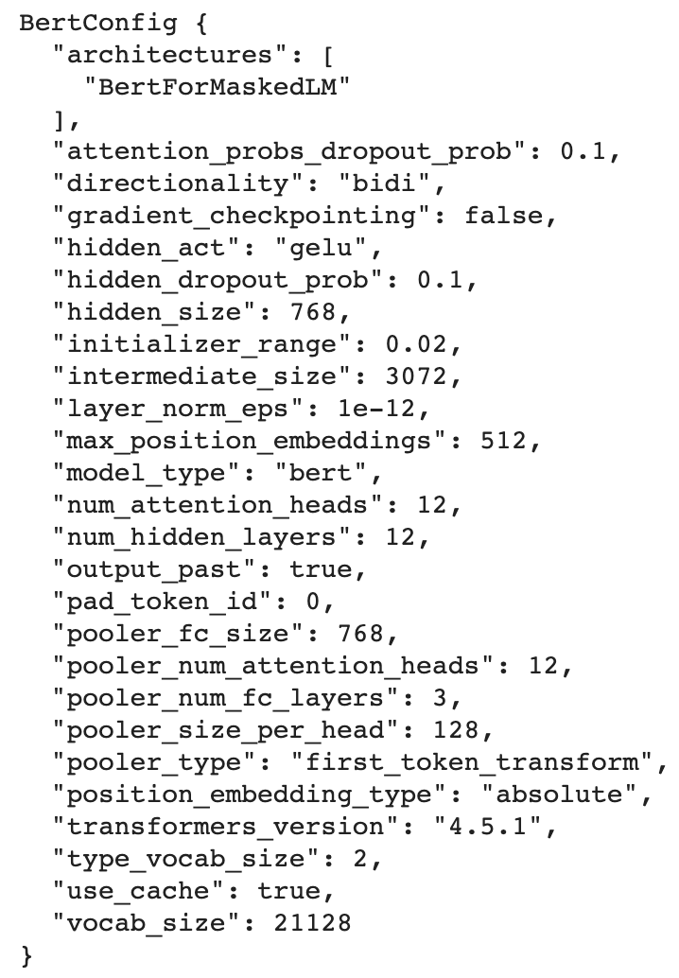
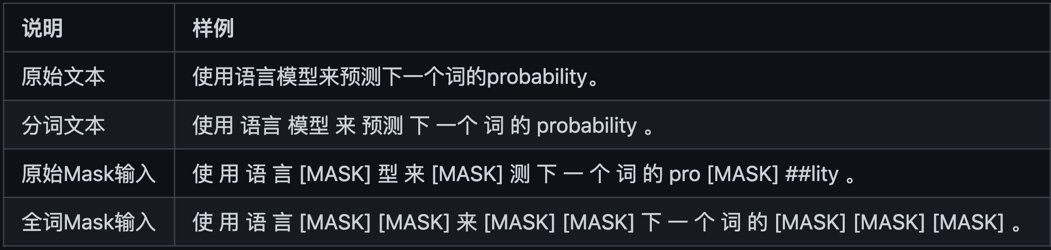
Pretrained model for classification + QA
hfl/chinese-bert-wwm
Whole word masking
configure: BertMaskedLM
T
3
🠺
🠺
Notes:
https:/m/github.com/ymcui/Chinese-BERT-wwm
It modifies the previous training sample generation strategy
Raise accuracy for Chinese token/sentence prediction

Slide 20
Why two models?
Simplify our task and divide into two steps: Classification and Question Answering
First classify YES/NO or SPAN questions
Classified result (SPAN) will feed into QA model
T
3
🠺
🠺

Slide 21
Classification--Data preprocessing
Unbalanced Data: leads to biased training result
YES: 3,565; NO: 1,543
Other questions: 34,225
Ratio 1:6.7
Solution: Undersampling
Randomly select 6,500 data from Other question set
Randomly merge with YES/NO set
Result: 11,608 (5,108 YES/NO+6,500 Other)
T
3
🠺
🠺

Slide 22
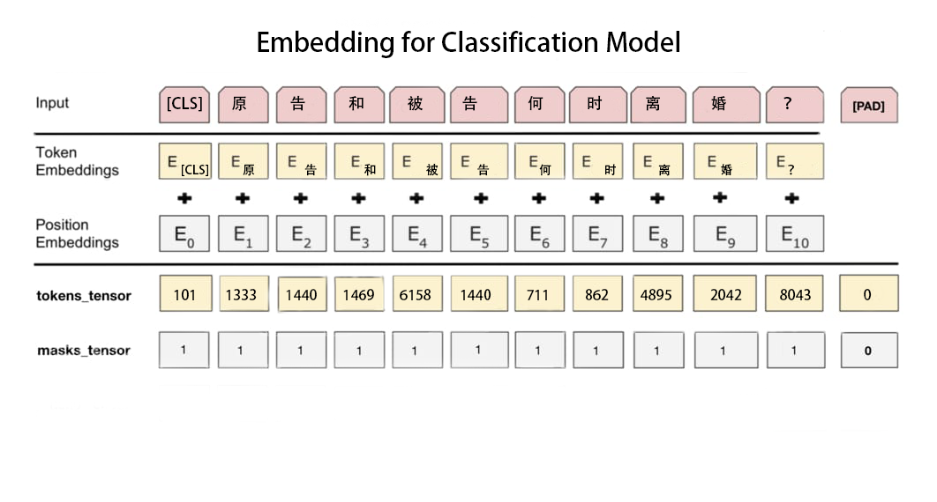
Classification--Embedding
T
3
🠺
🠺

Slide 23
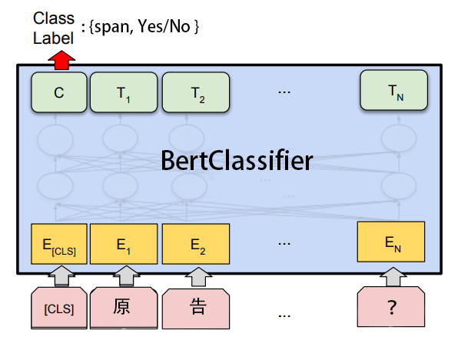
Classification--BertClassifier
Batch-size: 32
Hidden-size: 768
Num of labels: 2
Learning rate: 6.25e-5
Input size: (11608, 115)
Output size: (B, N) i.e. (32,2)
Epoch: 8
Activation: Tanh
Loss function: cross-entropy loss
T
3
🠺
🠺
Notes:
cross-entropy loss of the Softmax layer: takes the class prediction vector corresponding to BERT’s <CLS> token, multiplies it with the classification layer weights

Slide 24
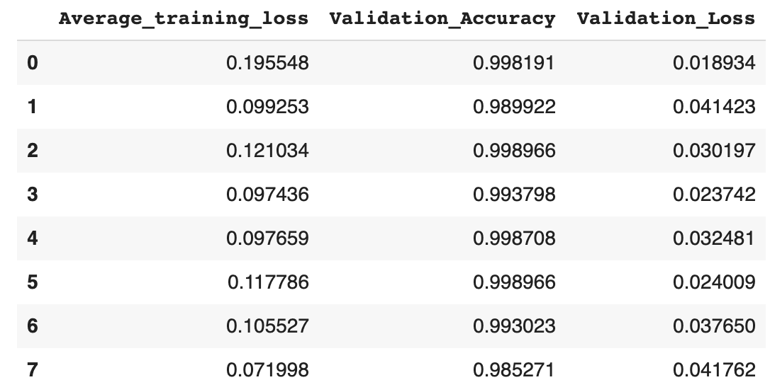
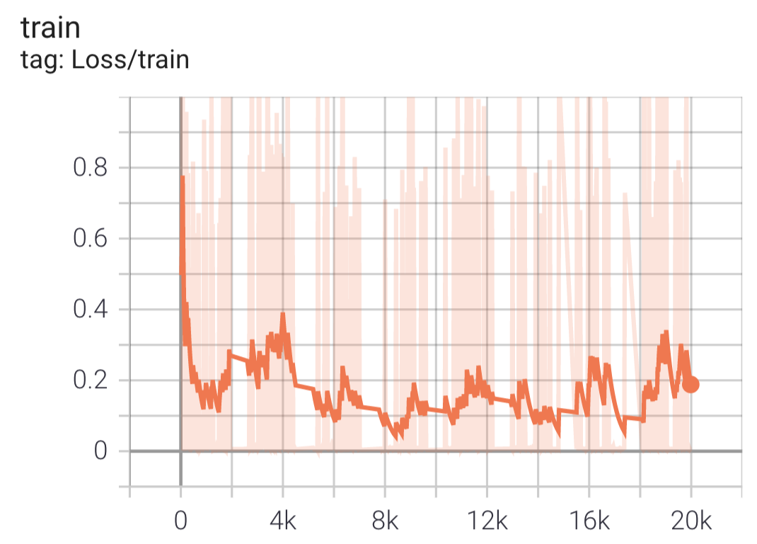
Classification--Result+evaluation
Test accuracy: 98.2946%
Test loss: 0.015154
T
3
🠺
🠺

Slide 25
QA--Data preprocessing
Filtering YES/NO question type to train QA
34,108 left
Filtering wrong [start] and [end] index
32,570 left
T
3
🠺
🠺

Slide 26
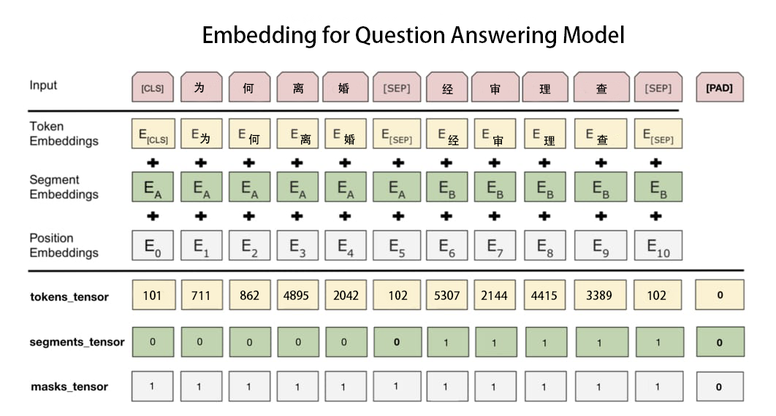
QA--Embedding
T
3
🠺
🠺

Slide 27
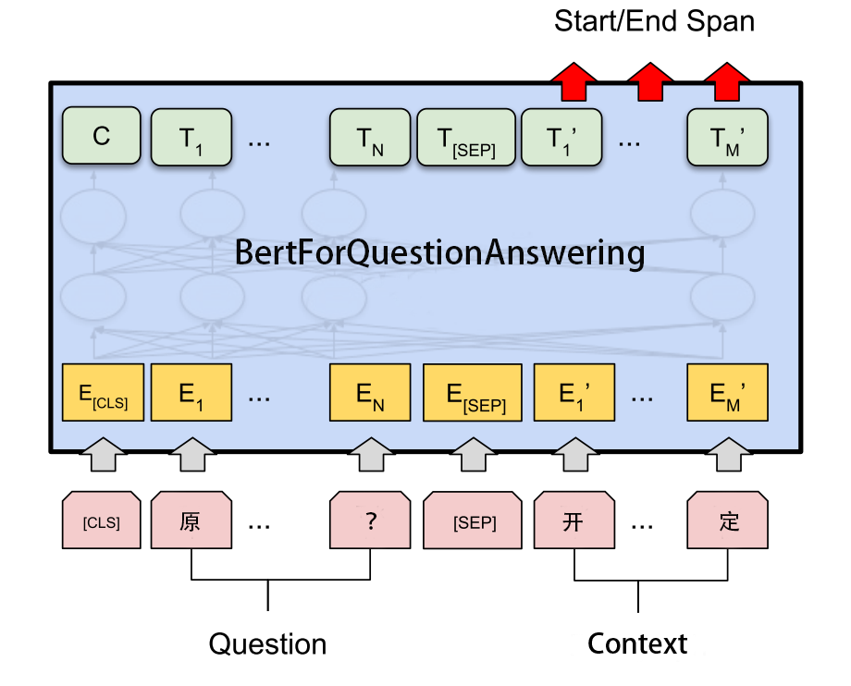
QA--BertForQuestionAnswering
Batch-size: 6
Hidden-size: 768
Two logits
Learning rate: 6.25e-5
Input size: (32,570, 259)
Output size: (B, N) i.e. (6,259)
Epoch: 10
Activation: Tanh
Loss function: cross-entropy loss
T
3
🠺
🠺
Notes:
cross-entropy loss of the Softmax layer: takes the class prediction vector corresponding to BERT’s <CLS> token, multiplies it with the classification layer weights

Slide 28
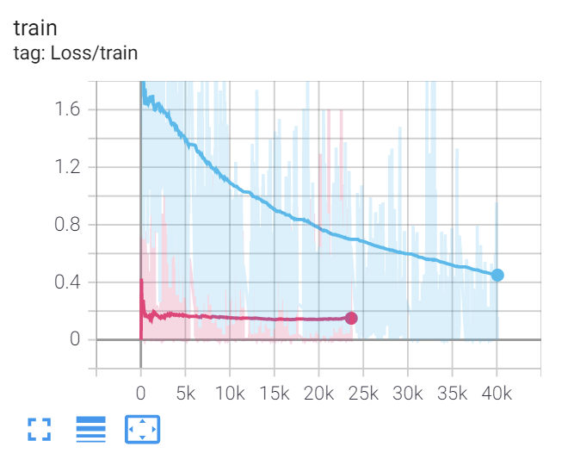
QA--Result+evaluation
Test Accuracy: 73.4109%
Test Loss: 1.863349
F1-score: 0.81197
T
3
🠺
🠺

Slide 29
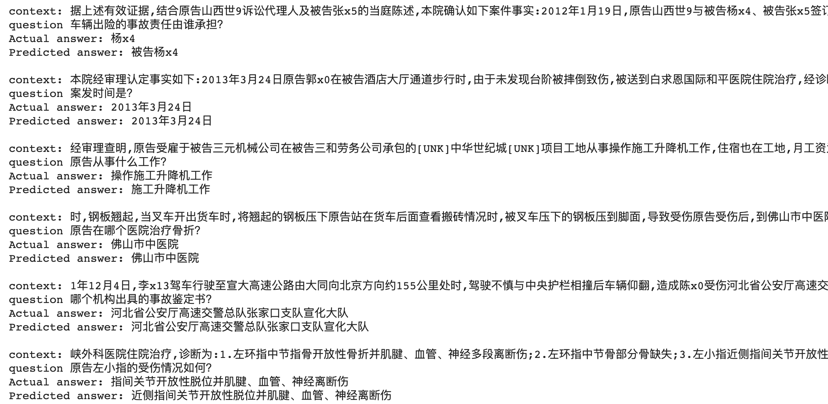
DEMO
T
3
🠺
🠺

Slide 30
4
Error Analysis
T
3
🠺
🠺
Classification attempts
Out of memory
Tokenizer

Slide 31
Error Analysis I
Classification approach 1
Input: [CLS] Question [SEP] Context [SEP]
Output: three classes YES/NO/SPAN
Classification approach 2
Input: [CLS] Question
Output: two classes i.e. whether it belongs to YES/NO question type
T
4
🠺
🠺
Bad Performance!!!
Much longer context
Questions unable to answer
Not enough data
Notes:
Classification model
First: three class classification, 0:span, 1:YES, 2:NO, input of question + context
The performance is not good, with loss around 3, and it’s probably because:
1: to distinguish whether a question has a YES/NO answer or span we only need question, and context are not necessary and they are too long, which might disturb the classification
2: there are some questions that are unable to answer, so the answer is not yes/no, neither span, but none, which also disturb the classification
3: there are NOT many qa pairs that has an answer of YES/NO, so when split the YES/NO questions into two classes, class size smaller, data sizes more unbalanced
To improve the performance,
Our solution is to
1:only put question as input,
2: group yes/no questions into one class, so data size is more balanced

Slide 32
Error Analysis II
T
4
🠺
🠺
Cuda out of memory:
Reduce batch size in training: 32 → 6
Set torch no_grad() in validation and test
Notes:
For other problems, we run out of cuda memory.
When trainning the qa model,
To fix that we:

Slide 33
Error Analysis III
T
4
🠺
🠺
Unmatched tokenizer between question and context
Answers longer than cut context
Answer tokenization different from context
Example:
Answer tokens: ‘2016’ ‘年’ ‘5’ ‘月’
Context tokens: ‘严’ ‘x1’ ‘#2016’ ‘年’
Notes:
And during data preprocessing, we have unmatched tokenizer btw question and context
Another error case is in the data preprocessing part
For train set, we extract answers from context according to the start index and our truncation method, however in several pieces of data,
The extracted answers does not match with the ground truth answer.
There are about 100 problematic data in the trainset, less than 10 for both validation and test set.
Currently we directly drop those data since it is only a very small number of them.

Slide 34
5
Future Work
T
5
🠺
🠺
Slide window
Multi-task model
Tokenizer
Answer YES/NO

Slide 35
Future Work
T
5
🠺
Train: Slide window
Current: fixed window 64+[start]+128
Slide window: length 300
Multitask Model: combine two models into one
Different tokenizer between answer and context
Answer YES/NO questions
🠺
Notes:
Here are the things we think could be improved for future work:
1: about the input context into the model.
When we train the model, for context that are too long, we now truncated the context with a fixed window,
Taking 64 tokens before and 128 after the startindex position.
To improving the training, we might implement a slide window, which means to put all context into the train model. The slide window will start from the very beginning of the context, take the max size of the context input length, then slides. For example, we first take [0,300],then [280,580] having a little overlap between each interval .(结果：qa结果会更好？)
2: for now our problem solution is to have two separate models, one for classification and one for qa.
For improvement we could combine the two parts into one multitask model, so that if the classification gets mistake and leads to a large loss after the qa model, we could come back and fine tune the classification model. The fine tune process will be more cohesive.
3: as mentioned in the error analysis section, we have some problematic data that has a mismatch between answer and extracted context.
We could further improve the tokenizer to fix this problem.(什么叫different tokenizer)
4.last part is that, we could improve the classification so that it can not only distinguish whether its a yes/no question but also answer the yes /no questions
Multitask: https://towardsdatascience.com/when-multi-task-learning-meet-with-bert-d1c49cc40a0c

Slide 36
Thank you!
Any Questions?
🠺
🠺
Notes:
Multitask: https://towardsdatascience.com/when-multi-task-learning-meet-with-bert-d1c49cc40a0c
Here are the things we think could be improved:
1: the input context into the model.
When we train the model, because some context could be too long to put into the model, we now truncated the context with a fixed window,
Taking 64 tokens before and 128 after the startindex position.
To improving the training, we might implement a slide window, which means to put all context into the train model. The slide window will start from the very beginning of the context, take the max size of the context input length, then slides. For example, we first take [0,180],then [160,340] having a little overlap between.(结果：qa结果会更好？)
2: for now our problem solution is to have two separate models, one for classification and one for qa.
For improvement we could combine the two parts into one multitask model, so that if the classification gets mistake and leads to a large loss after the qa model, we could come back and fine tune the classification model. The fine tune process will be more cohesive.
3: as mentioned in the error analysis section, we have some problematic data that has a mismatch between answer and extracted context.
We could further improve the tokenizer to fix this problem.(什么叫different tokenizer)
4.last part of the future works is that, our current classification only classifies if the question has anwer of YES/NO or span, qa extracts

